Slide 1

BAN 210 – FINAL PROJECT AUTO MPG DATASET
By-
Rohan Sharma
(135812212)

Slide 2
AIM OF THE ANALYSIS
To determine the value of our target variable.
To determine which model is more accurate and by how much

Slide 3
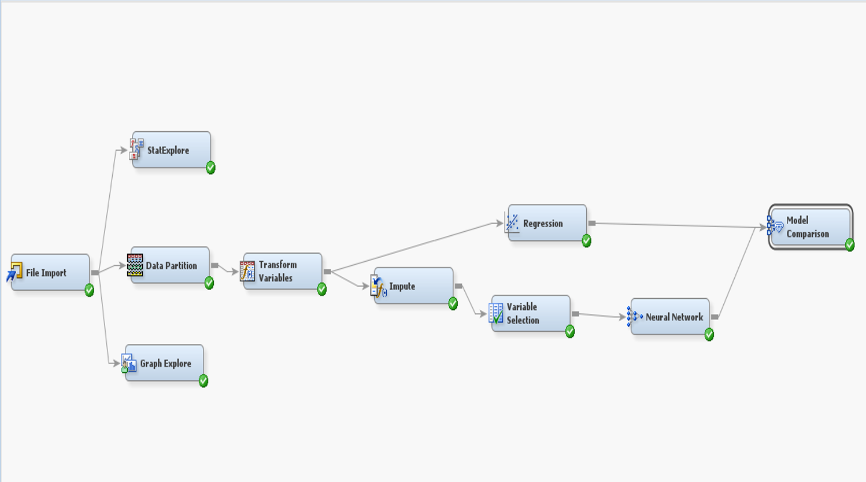
STEPS IN THE SAS MINER
The below steps/nodes
have been used for the analysis:
Step 1: File Import
Step 2: Stat Explore
Step 3: Graph Explore
Step 4: Data Partition
Step 5: Data Transformation
Step 6: Imputation
Step 7: Regression Model
Step 8: Variable Selection
Step 9: Neural Network
Step 10: Model Comparison

Slide 4
DATA DESCRIPTION
The information relates to the prediction of city-cycle fuel consumption in miles per gallon using 3 multivalued discrete attributes and 5 continuous features.
Attribute Information:
1. mpg: continuous (TARGET VARIABLE)
2. cylinders: multi-valued discrete
3. displacement: continuous
4. horsepower: continuous
5. weight: continuous
6. acceleration: continuous
7. model year: multi-valued discrete
8. origin: multi-valued discrete
9. car name: string (unique for each instance)

Slide 5
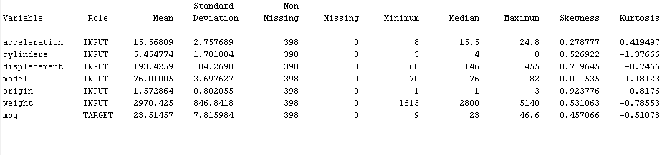
DATA DESCRIPTION

Slide 6
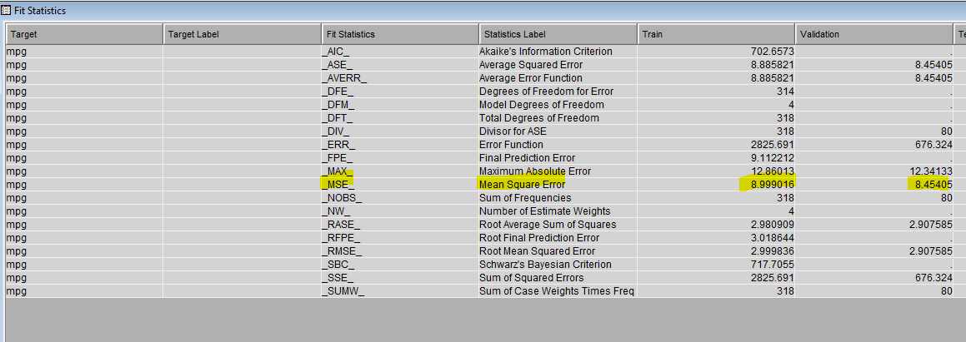
LINEAR REGRESSION MODEL
MSE = 8.45

Slide 7
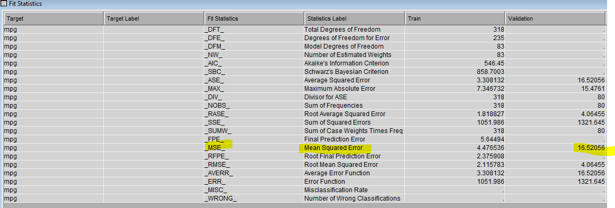
NEURAL NETWORK MODEL
MSE = 16.52

Slide 8
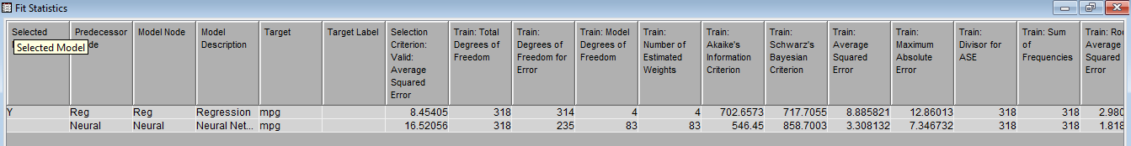
COMPARING MODELS
Comparing the two models, I calculated the Mean Squared Error (MSE). Since the MSE Score of the linear regression model (MSE-8.45) is lower than that of the neural network model (MSE-16.52), it performs better than the latter in terms of predicting the value of our target variable.

Slide 9
THANK YOU!

